Slide 1
Lecture 21: Searching Arrays

Slide 2
Homework #8 Review

Slide 3
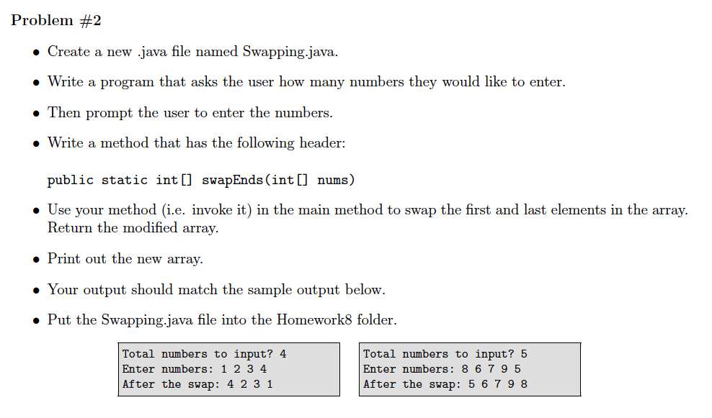

Slide 4
public static void main(String[] args)
{
Scanner kb = new Scanner(System.in);
System.out.print("Total numbers to input? ");
int total = kb.nextInt();
System.out.print("Enter numbers: ");
int[] array = new int[total];
for (int i = 0; i < array.length; i++)
array[i] = kb.nextInt();
array = swapEnds(array);
for (int i = 0; i < array.length; i++)
System.out.print(array[i] + " ");
}
public static int[] swapEnds(int[] nums)
{
int temp = nums[0];
nums[0] = nums[nums.length - 1];
nums[nums.length - 1] = temp;
return nums;
}

Slide 5
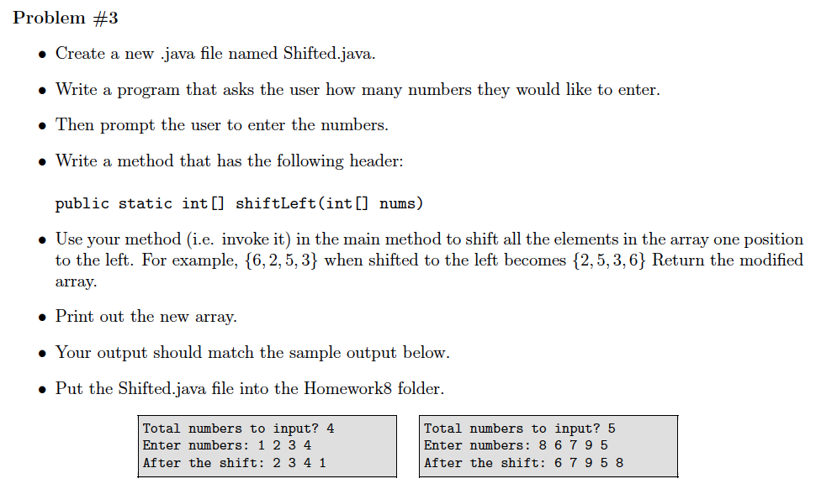

Slide 6
public static void main(String[] args)
{
Scanner kb = new Scanner(System.in);
System.out.print("Total numbers to input? ");
int total = kb.nextInt();
System.out.print("Enter numbers: ");
int[] array = new int[total];
for (int i = 0; i < array.length; i++)
array[i] = kb.nextInt();
array = shiftLeft(array);
for (int i = 0; i < array.length; i++)
System.out.print(array[i] + " ");
}
public static int[] shiftLeft(int[] nums)
{
int temp = nums[0];
for (int i = 0; i < nums.length - 1; i++)
nums[i] = nums[i + 1];
nums[nums.length - 1] = temp;
return nums;
}

Slide 7
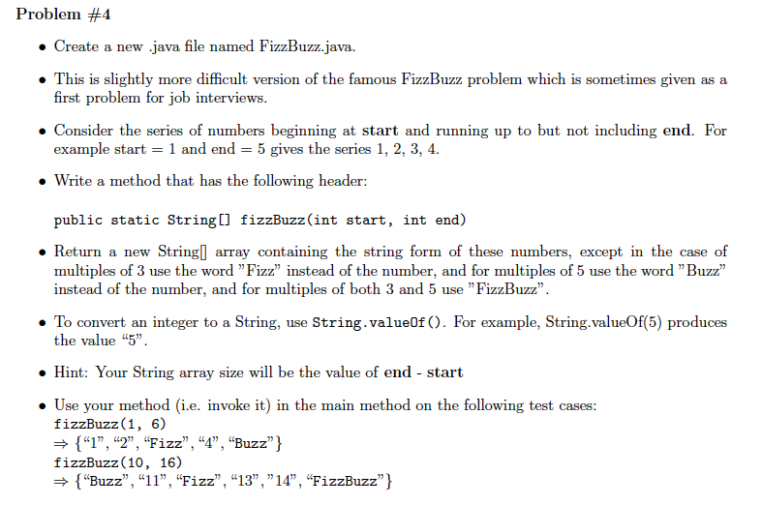

Slide 8
public static void main(String[] args)
{
String[] vals = fizzBuzz(1, 6);
for (int i = 0; i < vals.length; i++)
System.out.print(vals[i] + " ");
String[] vals2 = fizzBuzz(10, 16);
for (int i = 0; i < vals2.length; i++)
System.out.print(vals2[i] + " ");
}
public static String[] fizzBuzz(int start, int end)
{
String[] array = new String[(end - start)];
for (int i = start; i < end; i++)
{
if (i % 3 == 0 && i % 5 == 0)
array[i - start] = "FizzBuzz";
else if (i % 3 == 0)
array[i - start] = "Fizz";
else if (i % 5 == 0)
array[i - start] = "Buzz";
else
array[i - start] = String.valueOf(i);
}
return array;
}

Slide 9


What is searching?
Searching is the process of looking for a specific element in an array.
Searching is a common task in computer programming. Many algorithms and data structures are devoted to searching.
We are going to discuss two commonly used approaches, linear search and binary search.

Slide 10

Linear Search
The array that you’re searching through does not have to be sorted first.
It will stop searching when it finds the value that you are looking for and print out the index at which that value occurs.
If there are multiple occurrences of the same value, the linear search will print out the index of the first one it finds.

Slide 11
Find the index at which the value -10 occurs
32 | -2 | 87 | -10 | 3 | 15
0 | 1 | 2 | 3 | 4 | 5
✔
Find the index where the value 15 occurs
32 | -2 | 87 | -10 | 15 | 15
0 | 1 | 2 | 3 | 4 | 5
✔

Slide 12
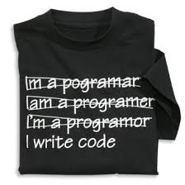
Translation to coding
Create a method called linearSearch that accepts an integer array and an integer as parameters and returns an integer value that represents the index at which the value was found. public static int linearSearch(int[] array, int num)
What do we return if we can’t find num?
Negative one because it’s not a possible value for an index.
Linear search means we search every element in the array from start to finish or until we find the number we are looking for. Therefore, we need a loop - a while loop.

Slide 13
public class LinearSearch
{
public static void main(String[] args)
{
int[] nums = {1, -9, 3, 8, 4, -2};
int index = linearSearch(nums, 8);
if (index != -1)
System.out.println(nums[index] + “ was found at index ” + index);
else
System.out.println(nums[index] + “ was not found.”);
}
public static int linearSearch(int[] array, int num)
{
boolean found = false;
int index = 0;
while (!found && index < array.length)
{
if (array[index] == num)
found = true;
else
index++;
}
if (!found)
index = -1;
return index;
}
}

Slide 14
Binary Search
The array that you’re searching through MUST be sorted first.
There are several different implementations of the binary search algorithm.
The BSA starts by finding the midpoint of the array and the element that occurs at the midpoint.
If the midpoint element value is bigger than the number we are searching for, it looks at the left-hand side of the midpoint. Otherwise it looks at the right-hand side.
It finds the midpoint again and continues to repeat this process until you’re down to one element. Either this is the correct element - or not!
If there are multiple occurrences of the same value, the binary search will print out the index of the first one it finds (which may not be the first one occurring).

Slide 15
Note: We round down if the the array or
portion we are looking at has an even
number of elements.
Search for 18
1
2
3
5
12
13
18
20
Is one term left?
18 > 5
1
2
3
5
12
13
18
20
Is one term left?
18 > 13

Slide 16
1
2
3
5
12
13
18
20
Is one term left?
18 > 18
1
2
3
5
12
13
18
20
Is one term left? Yes.
Is it the right term? Yes.

Slide 17
Translation to coding
Create a method called binarySearch that accepts an integer array and an integer as parameters and returns an integer value that represents the index at which the value was found. public static int binarySearch(int[] array, int num)
What do we return if we can’t find num?
Negative one because it’s not a possible value for an index.
Binary search also uses a while loop. However, we have to keep track of which part of the array we are looking at.

Slide 18
public class LinearSearch
{
public static void main(String[] args)
{
int[] nums = {-9, -2, 1, 3, 4, 8};
int index = binarySearch(nums, 8);
if (index != -1)
System.out.println(nums[index] + " was found at index " + index);
else
System.out.println(“Element was not found.");
}
...

Slide 19
. . .
public static int binarySearch(int[] array, int num)
{
int start = 0;
int end = array.length - 1;
int mid = (end + start)/2;
while (end != start)
{
if (num > array[mid])
{
start = mid + 1;
mid = (end + start)/2;
}
else
{
end = mid;
mid = (end + start)/2;
}
}
int index;
if (array[mid] == num)
index = mid;
else
index = -1;
return index;
}

Slide 20
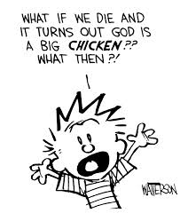
What if...?
Your array is not sorted first?
You have to sort it - using one of the sort algorithms presented in this course.
Selection sort
Bubble sort

Slide 21

It is time...
To form groups for your last lab!!!
Write your names of the people in your group down on a piece of paper and bring it up to me.

Slide 22
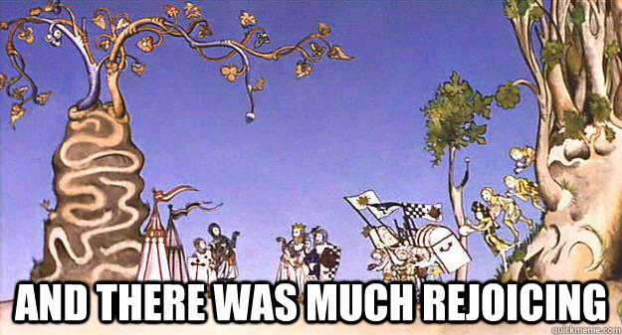

That’s all for today!
Lab #3 is posted and is due Wednesday, December 3rd.

